Slide 1
BANK LOAN CASE STUDY
BY- GULSHAN KUMAR

Slide 2
Project Description
The main aim of this project is to identify patterns that indicate if a customer will have difficulty paying their installments. This information can be used to make decisions such as denying the loan, reducing the amount of loan, or lending at a higher interest rate to risky applicants. The company wants to understand the key factors behind loan default so it can make better decisions about loan approval.

Slide 3
Approach
1. Data Acquisition and Familiarization
2. Data Cleaning With Python
3. Data Analysis in Python.
4. Visualization in Python

Slide 4
TECH- STACK USED
Google Collab :- It is used for data analysis and visualization.
MS Power Point:- It is used for making Presentation.

Slide 5
TaskS
1. Identify Missing Data and Deal with it Appropriately
2. Identify Outliers in the Dataset: Detect and identify outliers in the dataset
3. Analyse Data Imbalance: Determine if there is data imbalance in the loan application dataset and calculate the ratio of data imbalance
4. Perform Univariate, Segmented Univariate, and Bivariate Analysis
5. Identify Top Correlations for Different Scenarios

Slide 6
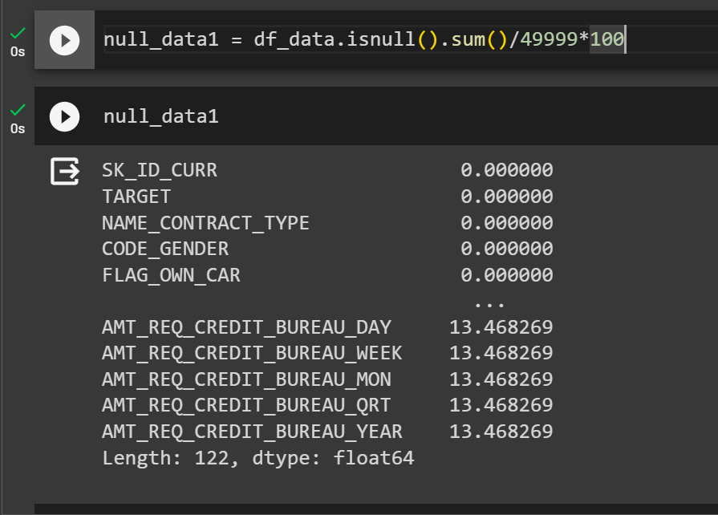
INSIGHTS
Task 1 :- Data Cleaning and Replacing Missing Values
No. of rows = 49999
No. of columns = 122
There are 49 col with null values which are
greater than 40%
After dropping 49 col new shape is
49999 rows and
73 columns

Slide 7
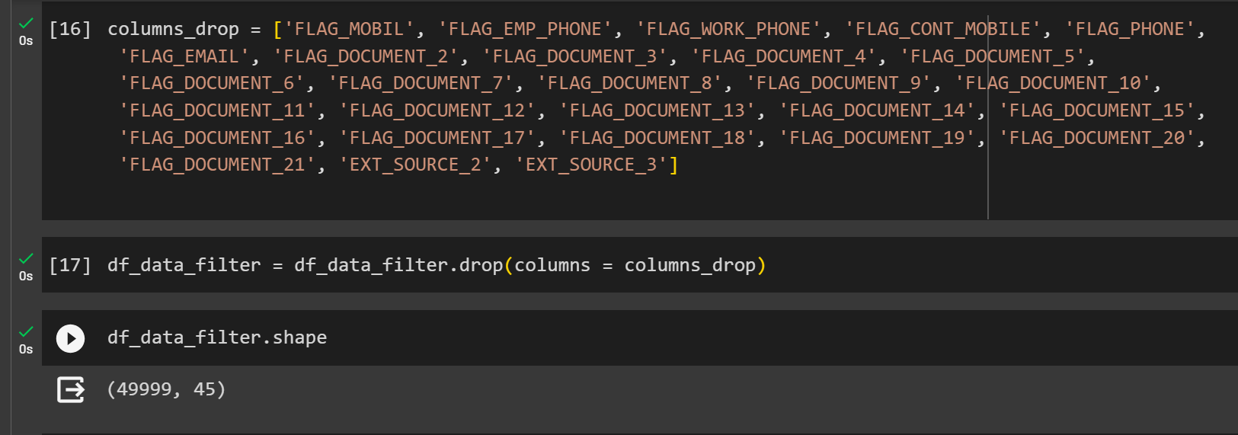
Now there are columns which are not usefull for
Insights and results
Now we after dropping null columns and unwanted columns we have a new shape of our dataframe i.e.
(49999, 45)

Slide 8
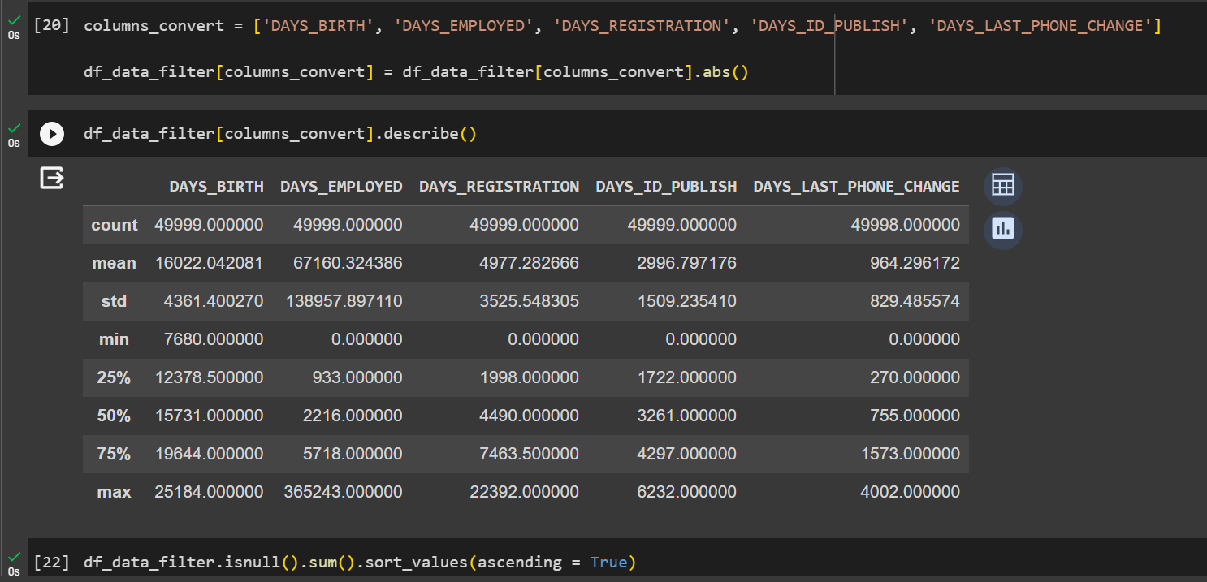
Now we have to convert days columns values to positive values because days can’t be negative.

Slide 9
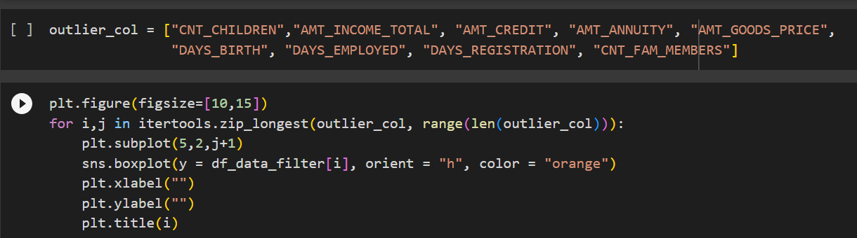
Task 2 : Identify Outliers in the Dataset
The box plot of these columns will reflect if they have outliers or not.

Slide 10
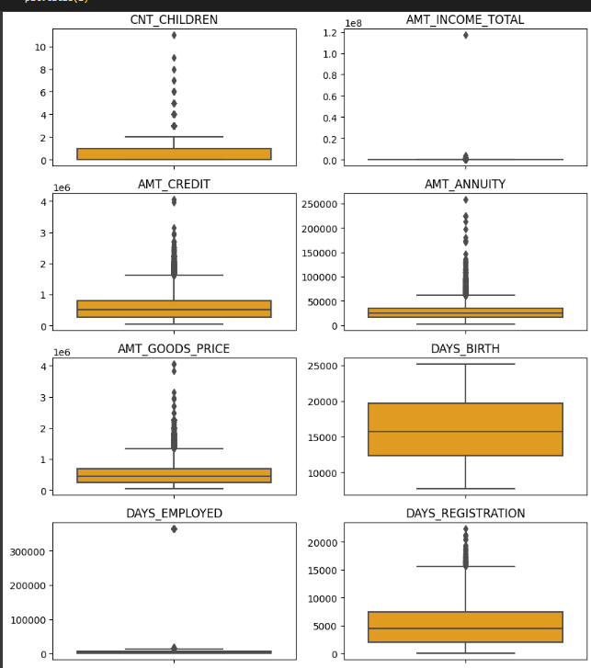

Slide 11
They Have some number of outliers
AMT_ANNUITY
AMT_CREDIT, AMT_GOODS_PRICE
CNT_CHILDREN
AMT_INCOME_TOTAL :- It has huge number of outliers which indicate that few of the loan applicants have high income when compared to the others.
3. DAYS_BIRTH has no outliers which means the data available is reliable.

Slide 12
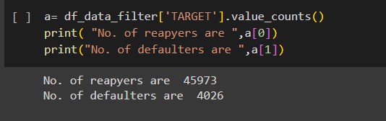
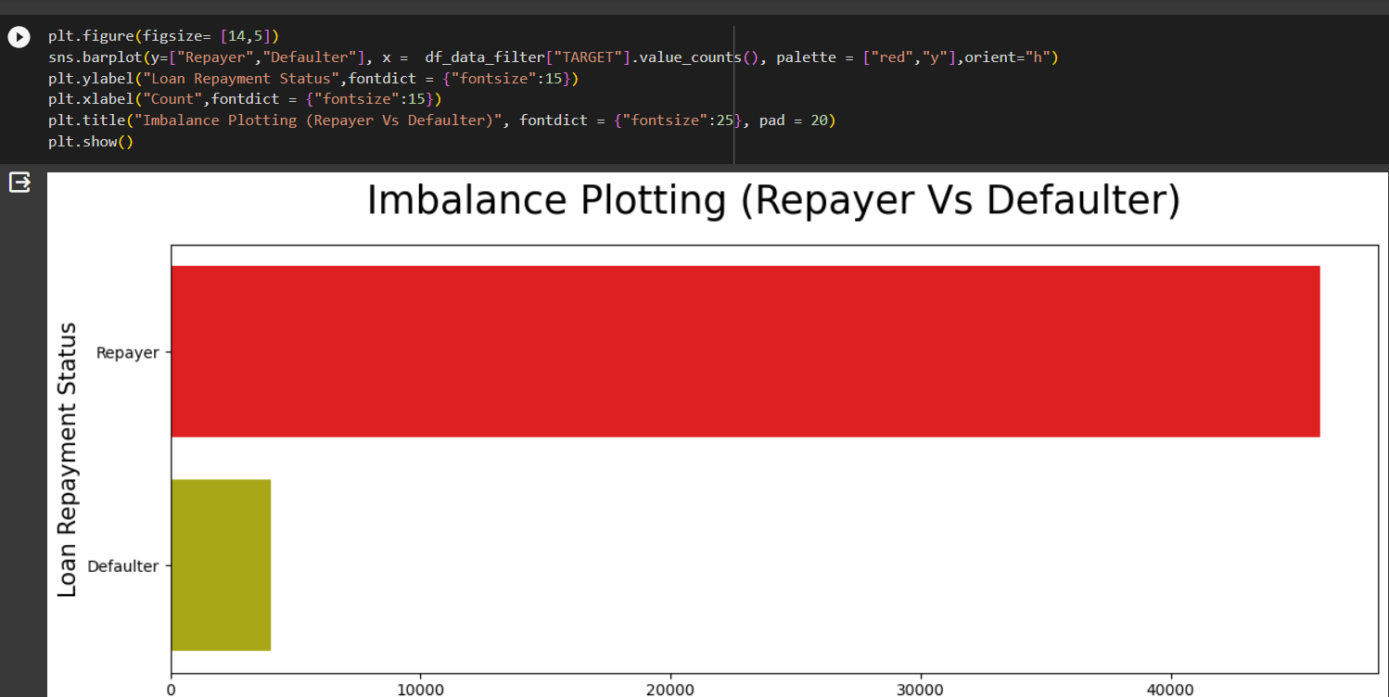
Task 3 : Data Imbalance

Slide 13
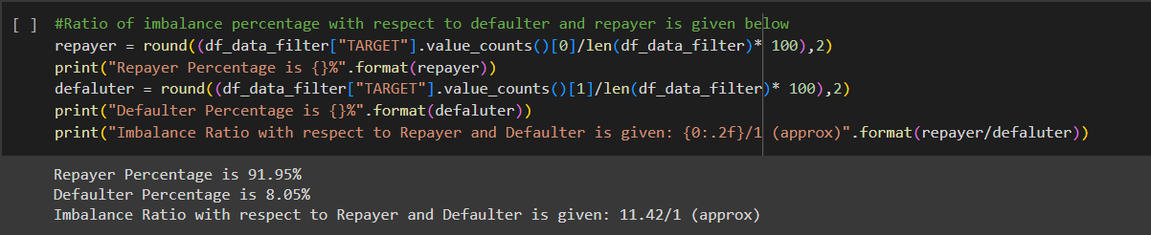
Ratio of imbalance percentage with respect to defaulter and repayer

Slide 14
Task 4 : Perform Univariate, Segmented Univariate, and Bivariate Analysis
To do the analysis, various functions are created to divide the data sets into categorical and numeric datasets
To see functions go to the google collab file attached to the ppt.

Slide 15
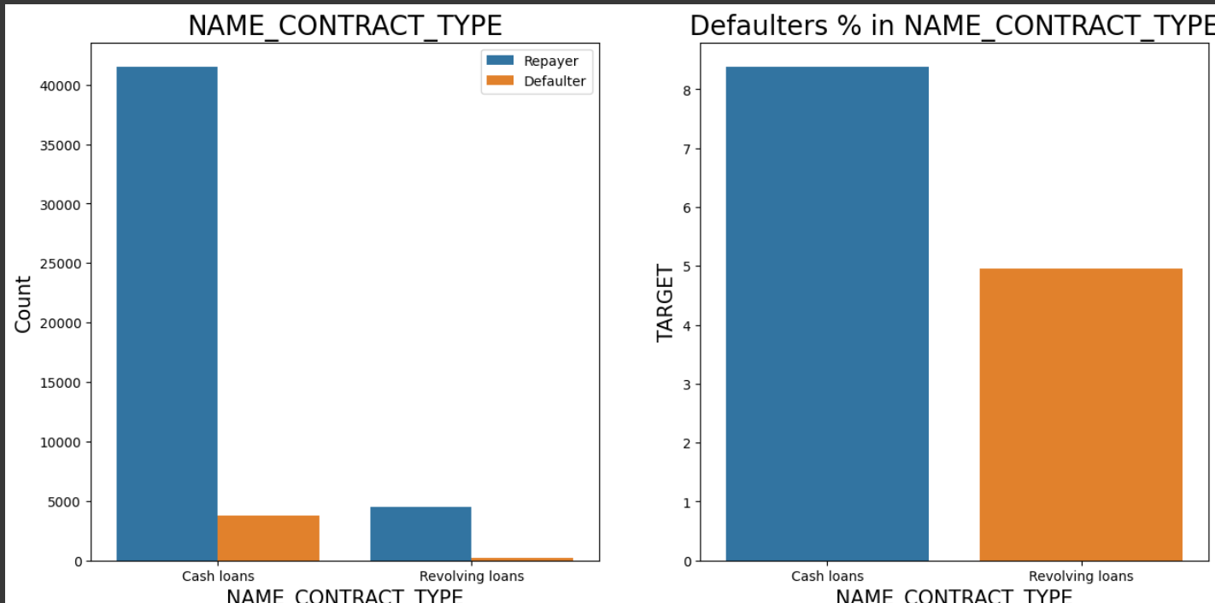
CATEGORICAL SEGMENTED UNIVARAITE ANALYSIS
univariate(df_data_filter,"NAME_CONTRACT_TYPE","TARGET",False,False,True)

Slide 16
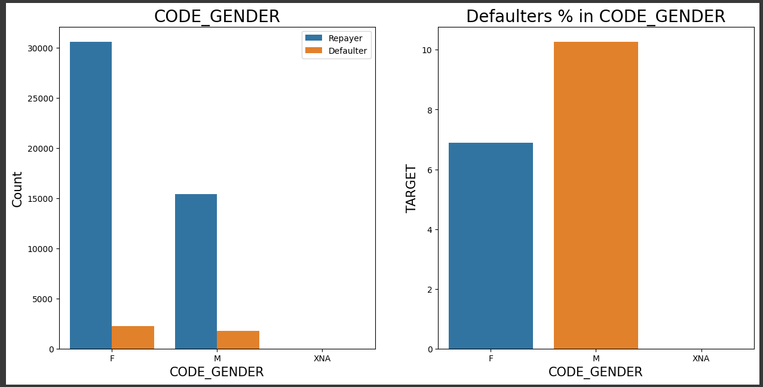
Checking the type of Gender on loan repayment status
univariate(df_data_filter,"CODE_GENDER","TARGET",False, False, True)

Slide 17
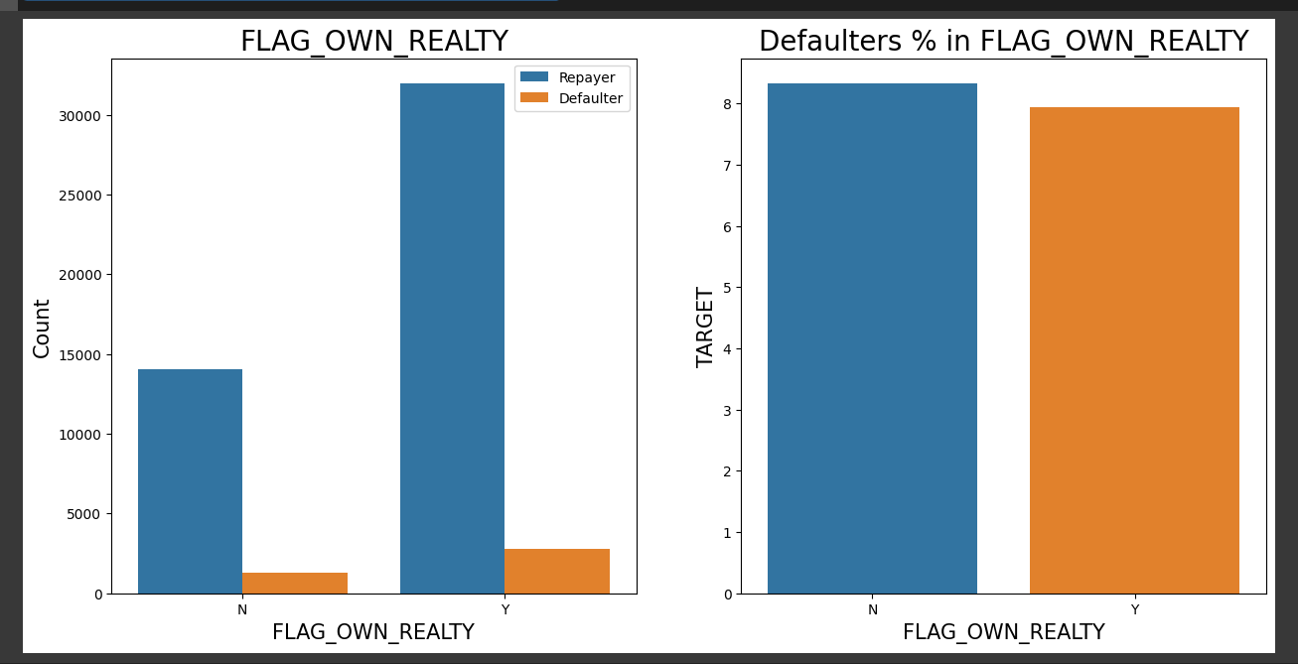
Checking if owning a real estate is related to loan repayment status
univariate(df_data_filter,"FLAG_OWN_REALTY","TARGET",False,False,True)

Slide 18
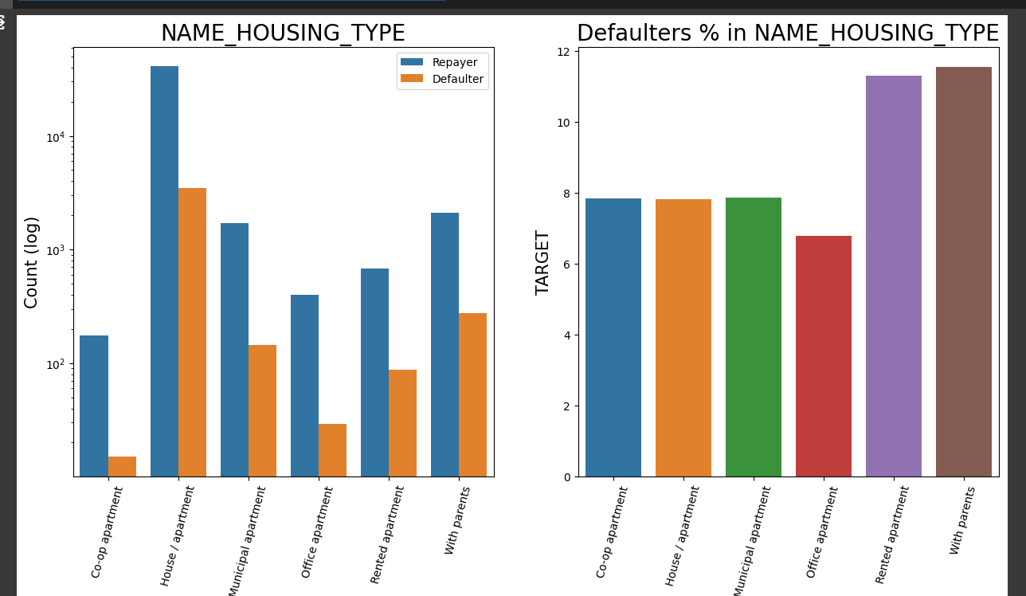
Analyzing Housing Type based on loan repayment status
univariate(df_data_filter,"NAME_HOUSING_TYPE","TARGET",True, True, True)

Slide 19
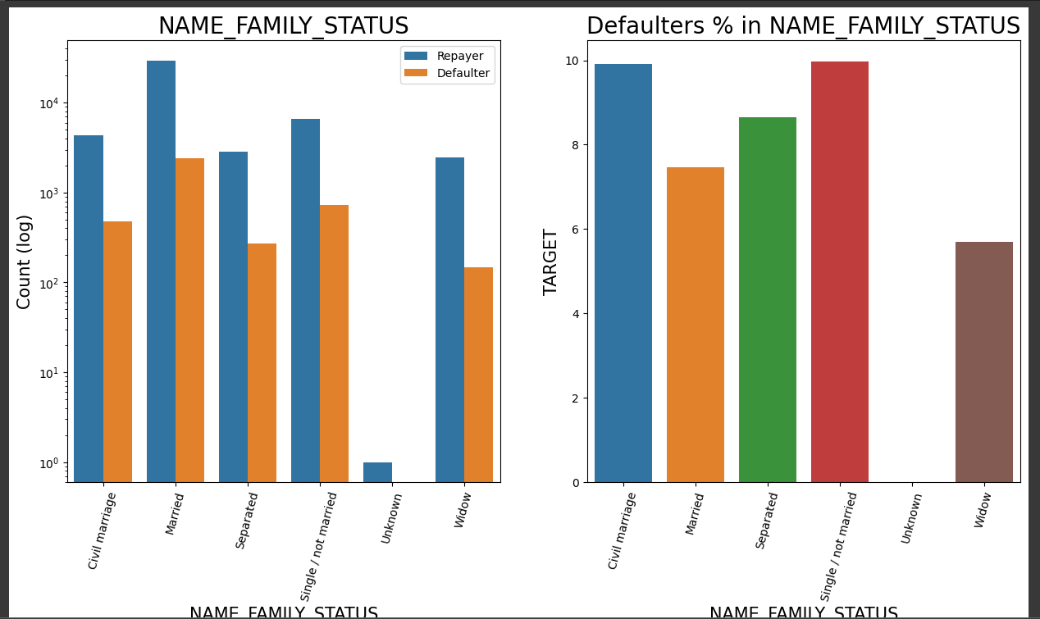
Analyzing Family status based on loan repayment status
univariate(df_data_filter,"NAME_FAMILY_STATUS","TARGET",True,True,True)

Slide 20
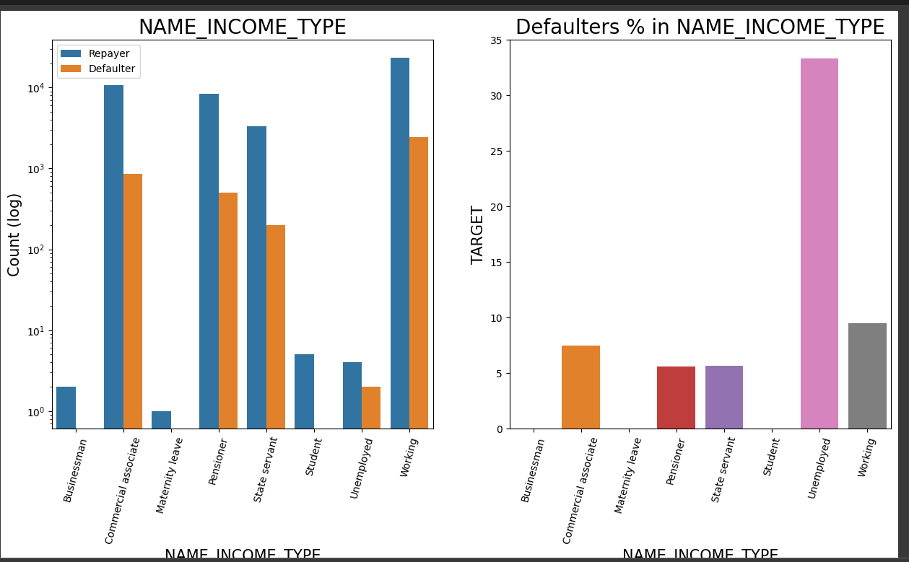
Analyzing Income Type based on loan repayment status
univariate(df_data_filter,"NAME_INCOME_TYPE","TARGET",True,True,True)

Slide 21
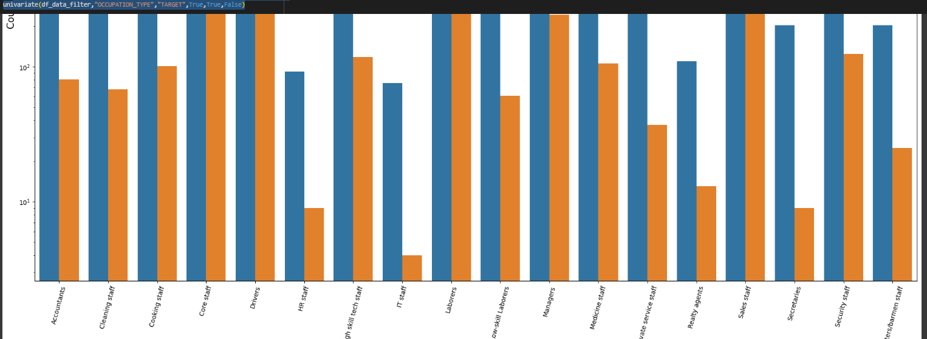
Analyzing Occupation Type where applicant lives based on loan repayment status
univariate(df_data_filter,"OCCUPATION_TYPE","TARGET",True,True,False)

Slide 22
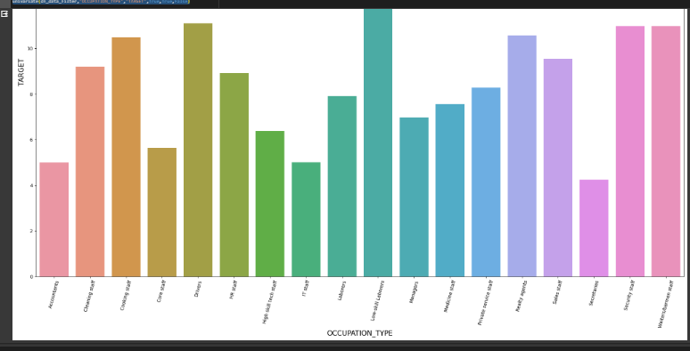

Slide 23
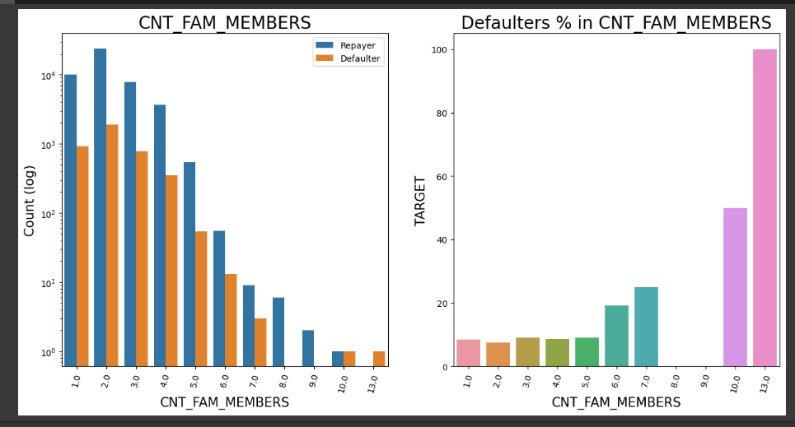
Analyzing Number of family members based on loan repayment status
univariate(df_data_filter,"CNT_FAM_MEMBERS","TARGET",True,True,True)

Slide 24
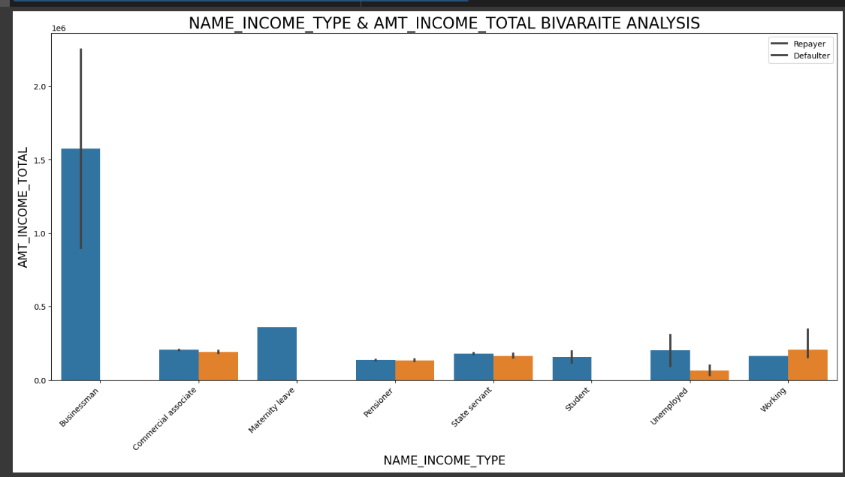
CATEGORICAL VARIABLES ANALYSIS
BIVARIATE/MULTIVARAITE ANALYSIS
Income type vs Income Amount Range on a Seaborn Barplot
bivariate_c("NAME_INCOME_TYPE","AMT_INCOME_TOTAL",df_data_filter,"TARGET",(18,8),['Repayer','Defaulter'])

Slide 25
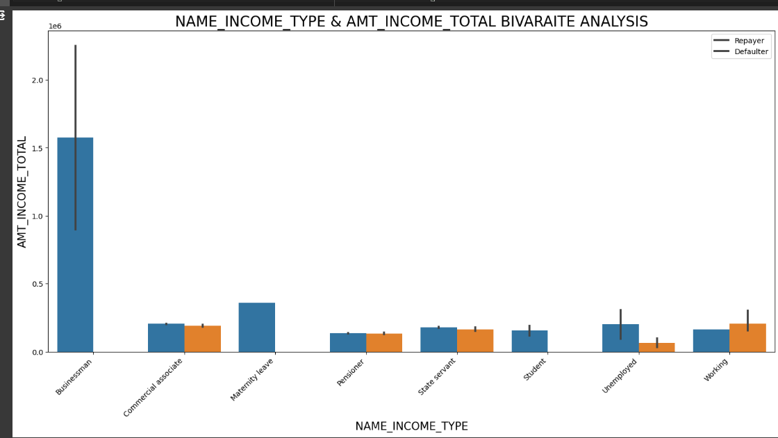
Income type vs Income Amount Range on a Seaborn Barplot
bivariate_c("NAME_INCOME_TYPE","AMT_INCOME_TOTAL",df_data_filter,"TARGET",(18,8),['Repayer','Defaulter'])

Slide 26
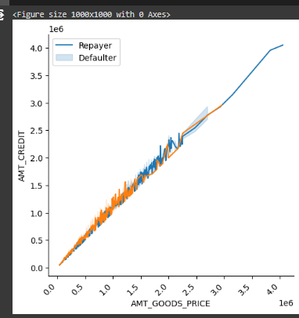
NUMERICAL VARIABLES ANALYSIS
BIVARIATE ANALYSIS
Checking the relationship between Goods price and credit and comparing with loan repayment status.
bivariate_n('AMT_GOODS_PRICE','AMT_CREDIT',df_data_filter,"TARGET", "line",['Repayer','Defaulter'])

Slide 27
Plotting pairplot between amount variable to draw reference against loan repayment status
When Annuity Amount > 15K and Good Price Amount > 20 Lakhs, there is a lesser chance of defaulters.
Loan Amount(AMT_CREDIT) and Goods price(AMT_GOODS_PRICE) are highly correlated as based on the scatterplot where most of the data are consolidated in form of a line.
There are very less defaulters for AMT_CREDIT >20 Lakhs.

Slide 28
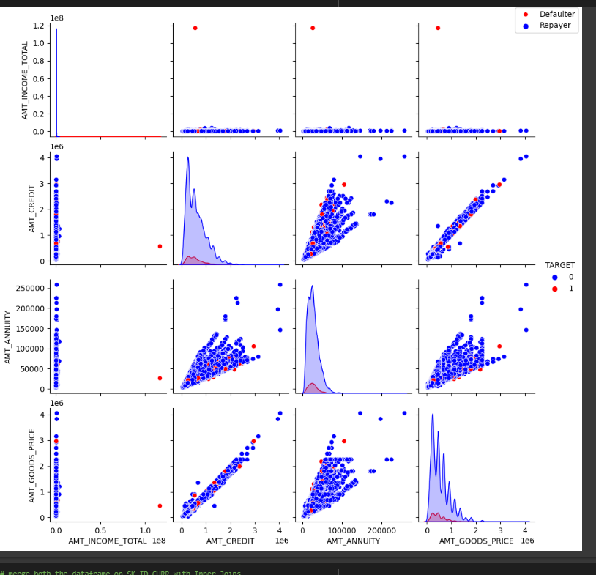

Slide 29
Task 5: CORRELATEION BETWEEN VARIABLES AND REPAYMENT/DEFAULT
CORRELATION BETWEEN VARIABLES WHEN LOAN REPAID
fig = plt.figure(figsize=(15,10))
ax = sns.heatmap(Repayer_df.corr(), cmap="RdYlGn",annot=True,linewidth =1)
1.Credit amount is highly correlated with:
Goods Price Amount
Loan Annuity
Total Income
2. We can also see that repayers have high correlation in number of days employed.

Slide 30
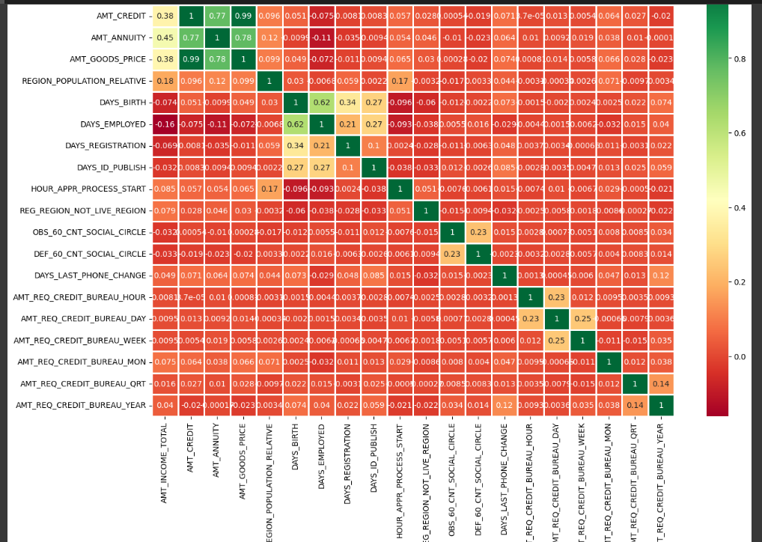

Slide 31
CORRELATION BETWEEN VARIABLES WHEN DEFAULT
fig = plt.figure(figsize=(15,10))
ax = sns.heatmap(Defaulter_df.corr(), cmap="RdYlGn",annot=True,linewidth =1)
Credit amount is highly correlated with good price amount which is same as repaid.
Credit amount is highly correlated with:
Goods Price Amount
Loan Annuity
Total Income

Slide 32
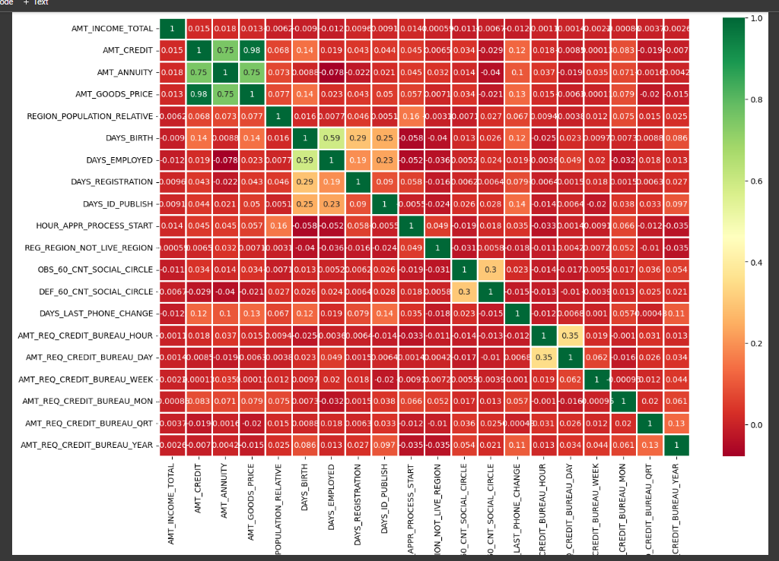

Slide 33
Results
Decisive Factor Whether An Applicant Will Be Repayer
NAME_EDUCATION_TYPE: Academic degree has less defaults.
NAME_INCOME_TYPE: Student and Businessmen have no defaults.
REGION_RATING_CLIENT: RATING 1 is safer.
ORGANIZATION_TYPE: Clients with Trade Type 4 and 5 and Industry type 8 have defaulted less than 3%.
DAYS_BIRTH: People above age of 50 have low probability of defaulting.
DAYS_EMPLOYED: Clients with 40+ year experience having less than 1% default rate.
AMT_INCOME_TOTAL:Applicant with Income more than 700,000 are less likely to default.
NAME_CASH_LOAN_PURPOSE: Loans bought for Hobby, Buying garage are being repaid mostly.
CNT_CHILDREN: People with zero to two children tend to repay the loans.

Slide 34
DECISIVE FACTOR WHETHER AN APPLICANT WILL BE DEFAULTER
CODE_GENDER: Men are at relatively higher default rate.
NAME_FAMILY_STATUS : People who have civil marriage or who are single default a lot.
NAME_EDUCATION_TYPE: People with Lower Secondary & Secondary education.
NAME_INCOME_TYPE: Clients who are either at Maternity leave OR Unemployed default a lot
REGION_RATING_CLIENT: People who live in Rating 3 has highest defaults.
OCCUPATION_TYPE: Avoid Low-skill Laborers, Drivers and Waiters/barmen staff, Security staff, Laborers and Cooking staff as their default rate is huge.

Slide 35
7. ORGANIZATION_TYPE: Organizations with highest percent of loans not repaid are Transport: type 3 (16%), Industry: type 13 (13.5%), Industry: type 8 (12.5%) and Restaurant (less than 12%). Self-employed people have relative high defaulting rate, and thus should be avoided to be approved for loan or provide loan with higher interest rate to mitigate the risk of defaulting.
8. DAYS_BIRTH: Avoid young people who are in age group of 20-40 as they have higher probability of defaulting.
9. DAYS_EMPLOYED: People who have less than 5 years of employment have high default rate.
10. CNT_CHILDREN & CNT_FAM_MEMBERS: Client who have children equal to or more than 9 default 100% and hence their applications are to be rejected.
11. AMT_GOODS_PRICE: When the credit amount goes beyond 3lakhs, there is an increase in defaulters.

Slide 36
Conculsion
90% of the previously cancelled client have actually repaid the loan. Record the reason for cancellation which might help the bank to determine and negotiate terms with these repaying customers in future for increase business opportunity.
88% of the clients who were refused by bank for loan earlier have now turned into a repaying client. Hence documenting the reason for rejection could mitigate the business loss and these clients could be contacted for further loans.

Slide 37
GOOGLE COLLAB PYTHON FILE LINK
https://colab.research.google.com/drive/1PcvaYpjK0xUccUtidqzouE_9j6uInNf2?usp=sharing

